Slide 1
Growing or Compressing Datasets
Cody Coleman (CEO and Co-Founder of Coactive AI)
MIT IAP 2023 Introduction to Data-Centric AI

Slide 2
Today’s Lecture
Why care about labels? Data-Centric vs Model-Centric AI (1/17)
Who labels and how? Dataset Creation and Curation (1/19)
What to label? Growing or Compressing Datasets (Today)
Active learning for growing datasets
Core-set selection for compressing datasets

Slide 3
Today’s Lecture
Why care about labels? Data-Centric vs Model-Centric AI (1/17)
Who labels and how? Dataset Creation and Curation (1/19)
What to label? Growing or Compressing Datasets (Today)
Active learning for growing datasets
Core-set selection for compressing datasets

Slide 4
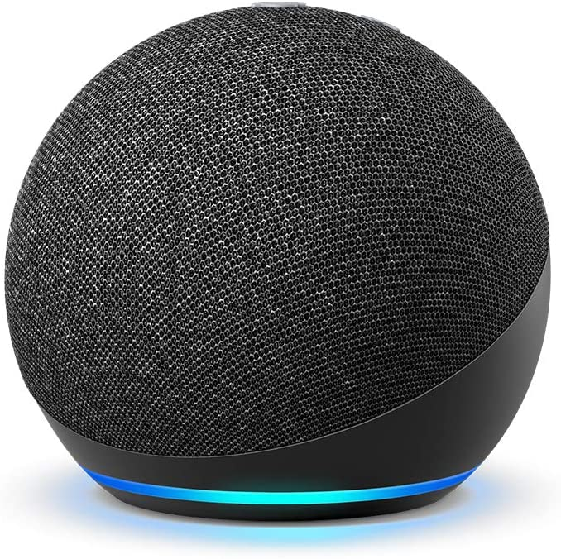
Why is selecting what to label important?
Speech recognition
Annotation at the word level can take ten times longer than the actual audio and annotating phonemes can take 400 times as long (e.g., nearly seven hours).
Zhu. “Semi-Supervised Learning with Graphs.” 2005
Settles et al. “Active Learning with Real Annotation Costs.” 2008
Settles. “Active Learning Literature Survey.” 2010

Slide 5
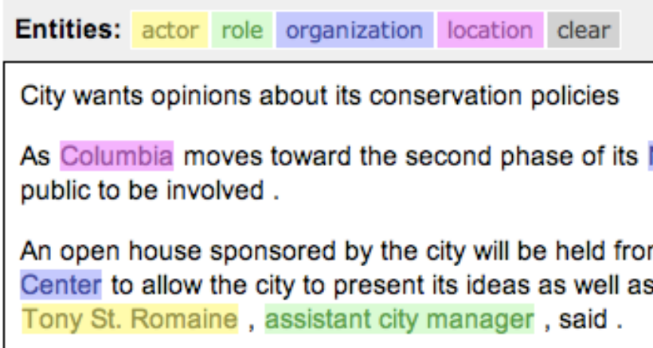
Why is selecting what to label important?
Speech recognition
Annotation at the word level can take ten times longer than the actual audio and annotating phonemes can take 400 times as long (e.g., nearly seven hours).
Information extraction
Locating entities and relations can take a half-hour or more for even simple newswire stories.
Zhu. “Semi-Supervised Learning with Graphs.” 2005
Settles et al. “Active Learning with Real Annotation Costs.” 2008
Settles. “Active Learning Literature Survey.” 2010

Slide 6
Why is selecting what to label important?
Passive vs. Active (Machine) Learning
Using the model to help us actively select examples can dramatically reduce the number of examples we need to label compared to passively selecting at random.
Coleman et al. “Similarity Search for Efficient Active Learning and Search of Rare Concepts.” 2022

Slide 7
What is active learning?

Slide 8
What is active learning?
The goal is to select the best examples to improve the model.
.

Slide 9
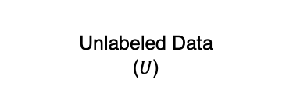
What is active learning?
Traditional Approach
Unlabeled Data ($U$)
The goal is to select the best examples to improve the model.
.

Slide 10
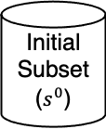
What is active learning?
Traditional Approach
Unlabeled Data ($U$)
Initial Subset ($s^{0}$)
The goal is to select the best examples to improve the model.
.

Slide 11
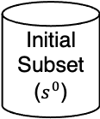
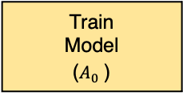
What is active learning?
Traditional Approach
Unlabeled Data ($U$)
Initial Subset ($s^{0}$)
Train
Model ($A_{0}^{}$)
The goal is to select the best examples to improve the model.
.

Slide 12
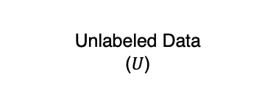
What is active learning?
Traditional Approach
Unlabeled Data ($U$)
Unlabeled Data ($U$)
Initial Subset ($s^{0}$)
Train
Model ($A_{0}^{}$)
The goal is to select the best examples to improve the model.
.

Slide 13
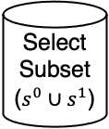
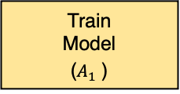
What is active learning?
Traditional Approach
Unlabeled Data ($U$)
Unlabeled Data ($U$)
Initial Subset ($s^{0}$)
Train
Model ($A_{0}^{}$)
Select Subset ($s^{0}∪s^{1}$)
Train
Model ($A_{1}^{}$)
The goal is to select the best examples to improve the model.
.

Slide 14
What is active learning?
Traditional Approach
Unlabeled Data ($U$)
Unlabeled Data ($U$)
…
Initial Subset ($s^{0}$)
Train
Model ($A_{0}^{}$)
Select Subset ($s^{0}∪s^{1}$)
Train
Model ($A_{1}^{}$)
The goal is to select the best examples to improve the model.
.

Slide 15
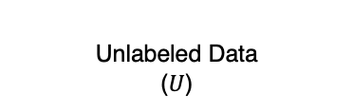
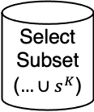
What is active learning?
Traditional Approach
Unlabeled Data ($U$)
Unlabeled Data ($U$)
Unlabeled Data ($U$)
…
Initial Subset ($s^{0}$)
Train
Model ($A_{0}^{}$)
Select Subset ($s^{0}∪s^{1}$)
Train
Model ($A_{1}^{}$)
Select Subset ($…∪s^{K}$)
The goal is to select the best examples to improve the model.
.

Slide 16
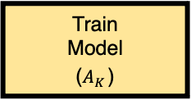
What is active learning?
Traditional Approach
Unlabeled Data ($U$)
Unlabeled Data ($U$)
Unlabeled Data ($U$)
…
Initial Subset ($s^{0}$)
Train
Model ($A_{0}^{}$)
Select Subset ($s^{0}∪s^{1}$)
Train
Model ($A_{1}^{}$)
Select Subset ($…∪s^{K}$)
Train
Model ($A_{K}^{}$)
The goal is to select the best examples to improve the model.
.

Slide 17

1-D: Passive vs. Active Learning
Active Learning
(i=0)
.
Passive Learning
(i=0)
.

Slide 18


1-D: Passive vs. Active Learning
Active Learning
(i=1)
.
Passive Learning
(i=1)
.

Slide 19


1-D: Passive vs. Active Learning
Active Learning
(i=2)
.
Passive Learning
(i=2)
.

Slide 20


1-D: Passive vs. Active Learning
Active Learning
(i=3)
.
Passive Learning
(i=3)
.

Slide 21


1-D: Passive vs. Active Learning
Active Learning
(i=4)
.
Passive Learning
(i=4)
.

Slide 22


1-D: Passive vs. Active Learning
Active Learning
(i=5)
.
Passive Learning
(i=5)
.

Slide 23


1-D: Passive vs. Active Learning
Active Learning
(i=6)
.
Passive Learning
(i=6)
.
active learning can give exponential speed-ups
Passive: err ~ n⁻¹
Active: err ~ 2^{-n}
.

Slide 24

1-D: Passive vs. Active Learning
Active Learning
(i=6)
.
Passive Learning
(i=25)
.
active learning can give exponential speed-ups
Passive: err ~ n⁻¹
Active: err ~ 2^{-n}
.

Slide 25

1-D: Passive vs. Active Learning
Active Learning
(i=6)
.
Passive Learning
(i=50)
.
active learning can give exponential speed-ups
Passive: err ~ n⁻¹
Active: err ~ 2^{-n}
.

Slide 26

1-D: Passive vs. Active Learning
Active Learning
(i=6)
.
Passive Learning
(i=75)
.
active learning can give exponential speed-ups
Passive: err ~ n⁻¹
Active: err ~ 2^{-n}
.

Slide 27

1-D: Passive vs. Active Learning
Active Learning
(i=6)
.
Passive Learning
(i=99)
.
active learning can give exponential speed-ups
Passive: err ~ n⁻¹
Active: err ~ 2^{-n}
.

Slide 28
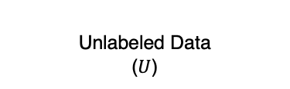
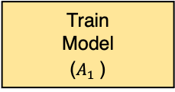
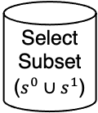
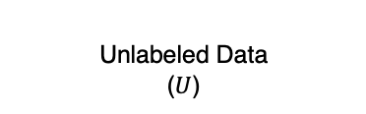
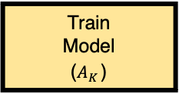
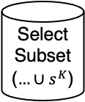
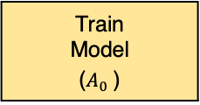
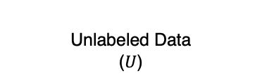
Practical Challenge #1: Big Models
Traditional Approach
Unlabeled Data ($U$)
Unlabeled Data ($U$)
Unlabeled Data ($U$)
…
Initial Subset ($s^{0}$)
Train
Model ($A_{0}^{}$)
Select Subset ($s^{0}∪s^{1}$)
Train
Model ($A_{1}^{}$)
Select Subset ($…∪s^{K}$)
Train
Model ($A_{K}^{}$)

Slide 29
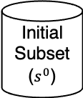
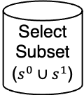
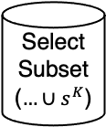
Practical Challenge #1: Big Models
Traditional Approach
Unlabeled Data ($U$)
Unlabeled Data ($U$)
Unlabeled Data ($U$)
…
Initial Subset ($s^{0}$)
Train
Model ($A_{0}^{}$)
Select Subset ($s^{0}∪s^{1}$)
Train
Model ($A_{1}^{}$)
Select Subset ($…∪s^{K}$)
Train
Model ($A_{K}^{}$)
computationally expensive

Slide 30
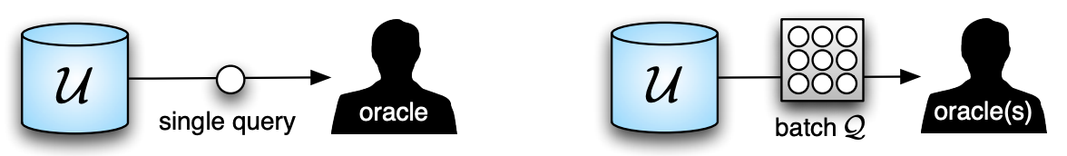
Practical Challenge #1: Big Models
Traditional Approach
Unlabeled Data ($U$)
Unlabeled Data ($U$)
Unlabeled Data ($U$)
…
Initial Subset ($s^{0}$)
Train
Model ($A_{0}^{}$)
Select Subset ($s^{0}∪s^{1}$)
Train
Model ($A_{1}^{}$)
Select Subset ($…∪s^{K}$)
Train
Model ($A_{K}^{}$)
computationally expensive
Settles. “From Theories to Queries: Active Learning in Practice.” 2011

Slide 31
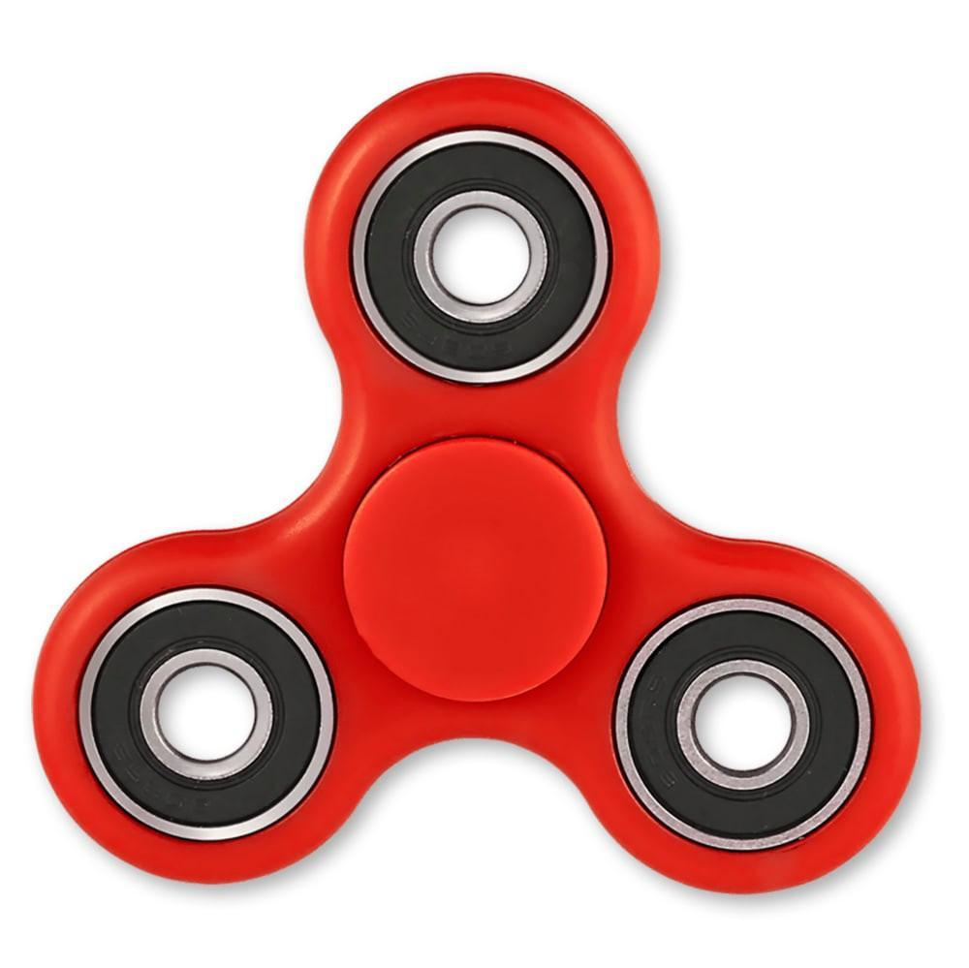
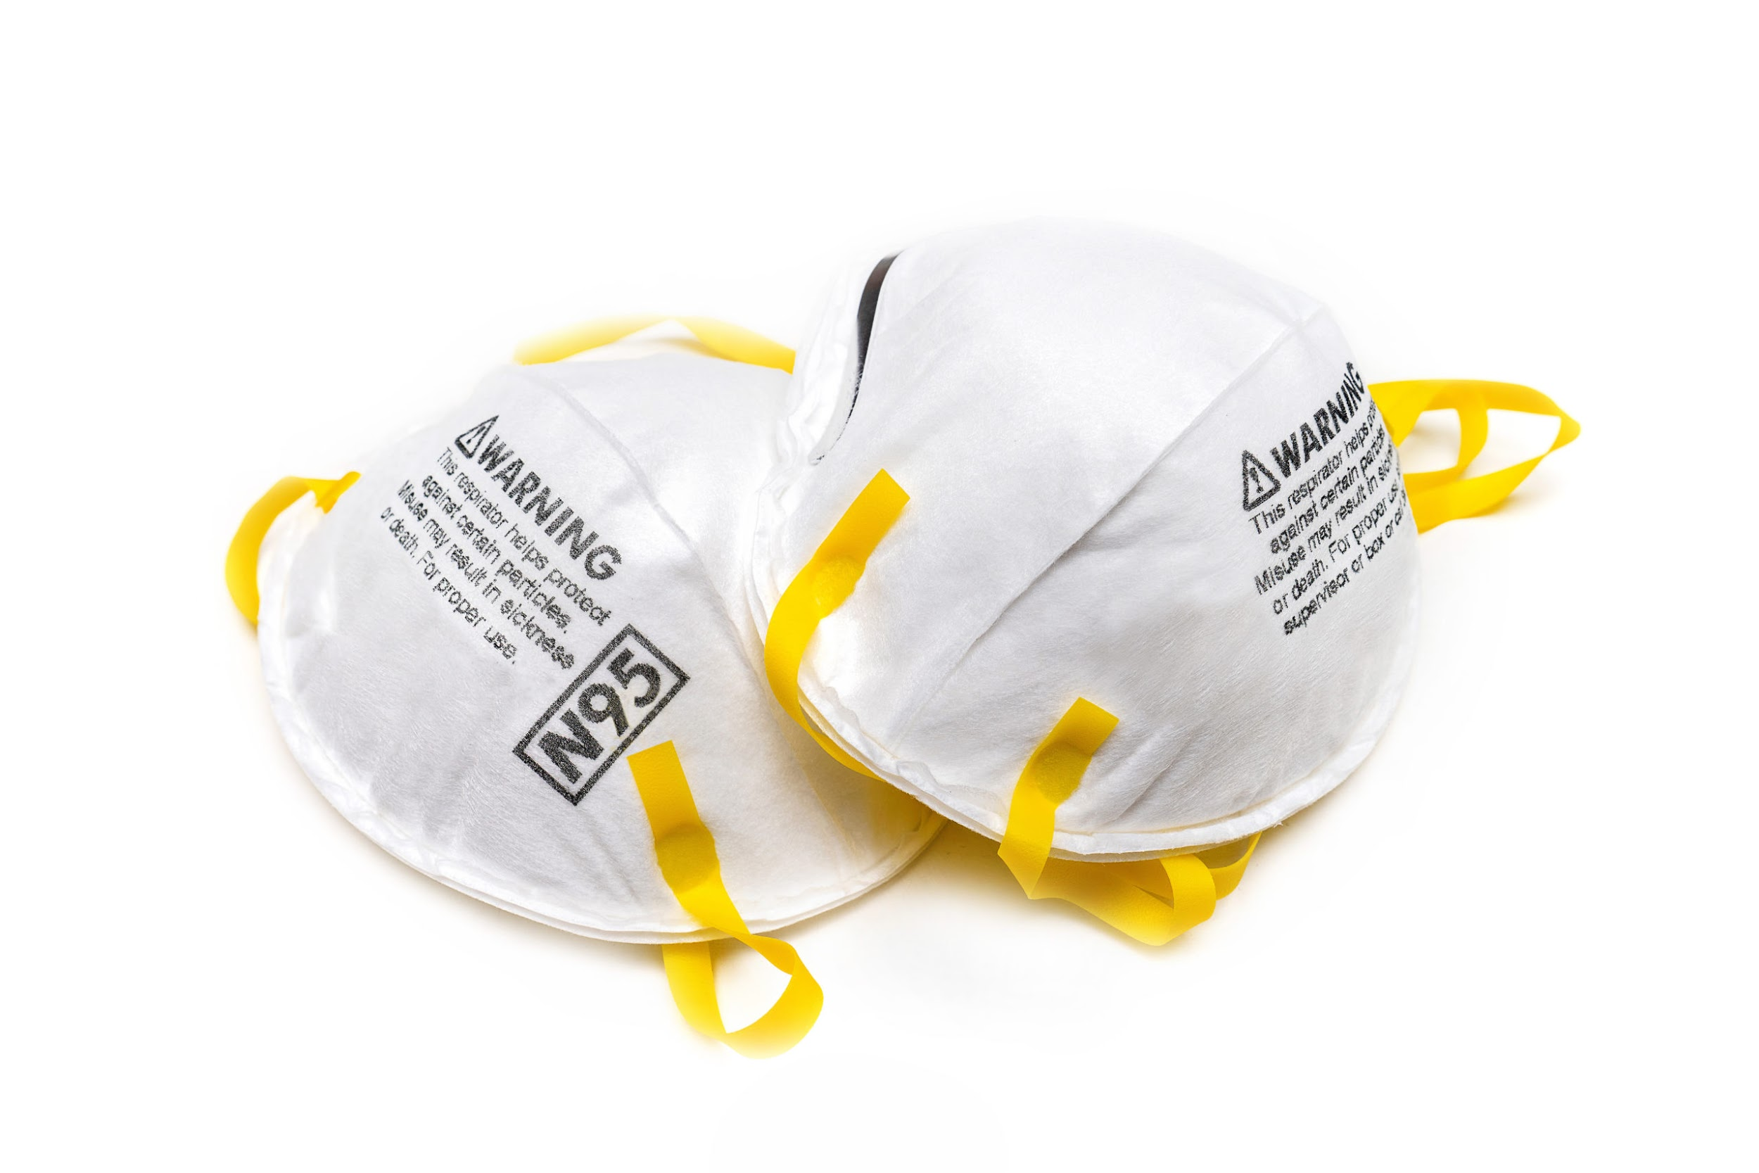
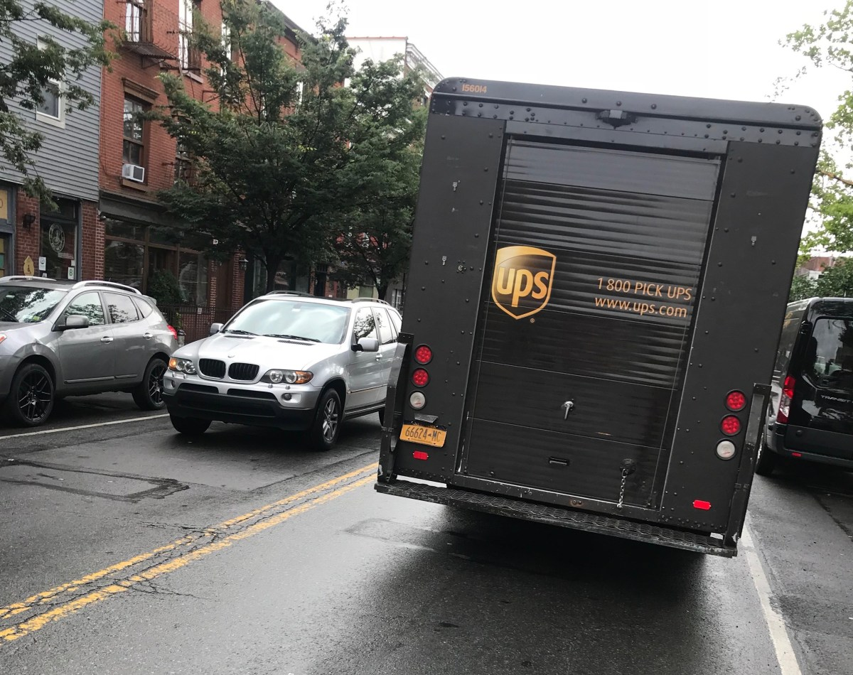
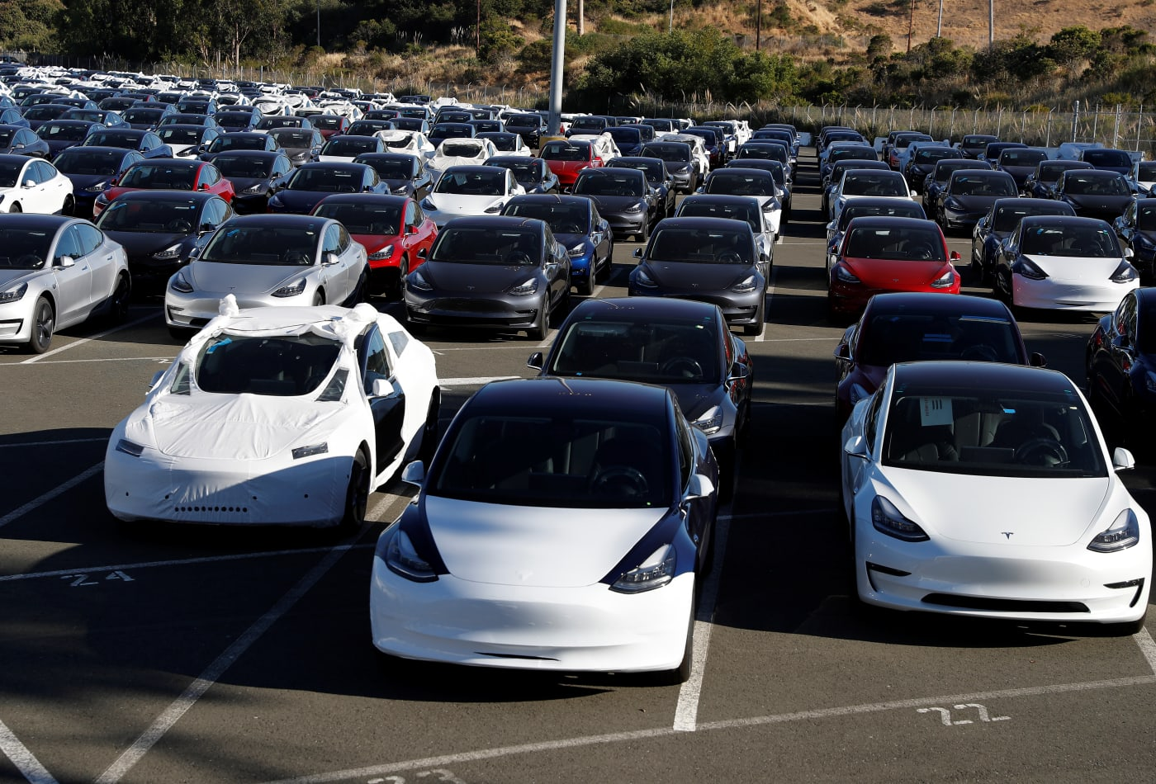
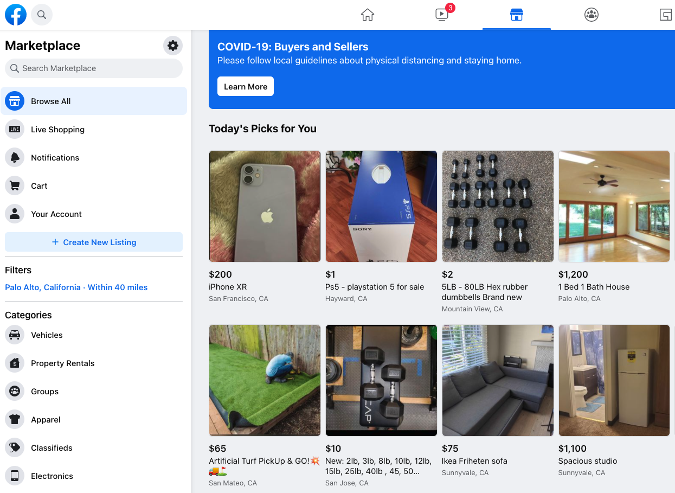
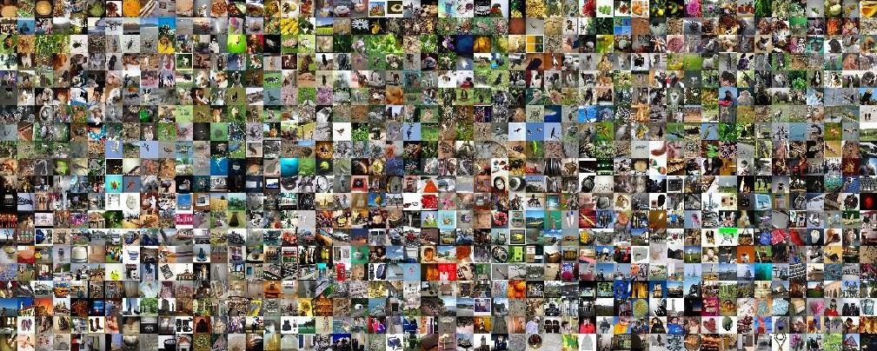
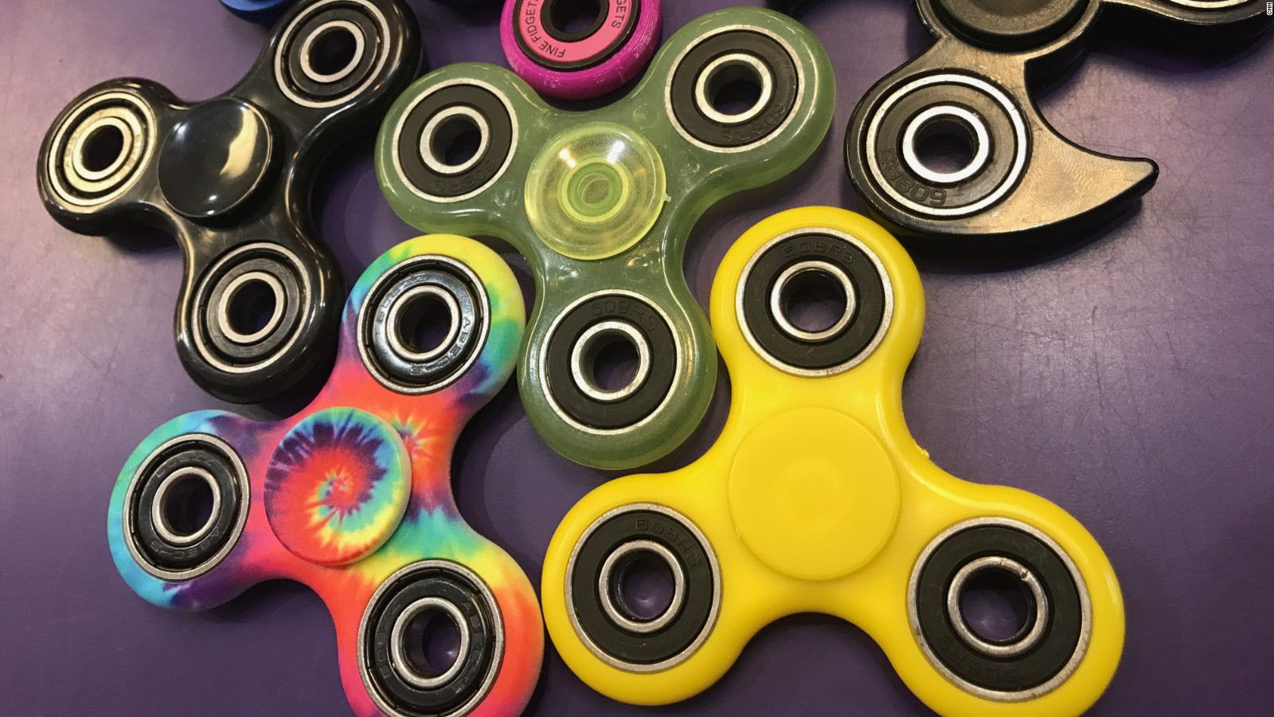
Practical Challenge #2: Big Data
Photo: Gersh Kuntzman
Photo: Stephen Lam | Reuters
Recommendation
Model Debugging
Integrity

Slide 32
Practical Challenge #2: Big Data
Traditional Approach
Unlabeled Data ($U$)
Unlabeled Data ($U$)
Unlabeled Data ($U$)
…
Initial Subset ($s^{0}$)
Train
Model ($A_{0}^{}$)
Select Subset ($s^{0}∪s^{1}$)
Train
Model ($A_{1}^{}$)
Select Subset ($…∪s^{K}$)
Train
Model ($A_{K}^{}$)
Coleman et al. “Similarity Search for Efficient Active Learning and Search of Rare Concepts.” 2022

Slide 33
Practical Challenge #2: Big Data
Traditional Approach
Bottleneck
Unlabeled Data ($U$)
Unlabeled Data ($U$)
Unlabeled Data ($U$)
…
Initial Subset ($s^{0}$)
Train
Model ($A_{0}^{}$)
Select Subset ($s^{0}∪s^{1}$)
Train
Model ($A_{1}^{}$)
Select Subset ($…∪s^{K}$)
Train
Model ($A_{K}^{}$)
Coleman et al. “Similarity Search for Efficient Active Learning and Search of Rare Concepts.” 2022

Slide 34
Practical Challenge #2: Big Data
Traditional Approach
Bottleneck
Unlabeled Data ($U$)
Unlabeled Data ($U$)
Unlabeled Data ($U$)
…
Initial Subset ($s^{0}$)
Train
Model ($A_{0}^{}$)
Select Subset ($s^{0}∪s^{1}$)
Train
Model ($A_{1}^{}$)
Select Subset ($…∪s^{K}$)
Train
Model ($A_{K}^{}$)
For example, running a single inference pass over 10 billion images with a ResNet-50 model would take 38 exaFLOPs or roughly 40 GPU-months.
Evaluating all of the unlabeled examples is too slow
Coleman et al. “Similarity Search for Efficient Active Learning and Search of Rare Concepts.” 2022

Slide 35
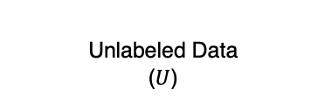
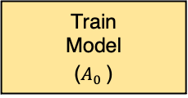
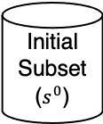
Practical Challenge #2: Big Data
Traditional Approach
Unlabeled Data ($U$)
Unlabeled Data ($U$)
Unlabeled Data ($U$)
…
Initial Subset ($s^{0}$)
Train
Model ($A_{0}^{}$)
Select Subset ($s^{0}∪s^{1}$)
Train
Model ($A_{1}^{}$)
Select Subset ($…∪s^{K}$)
Train
Model ($A_{K}^{}$)
Similarity search for Efficient Active Learning and Search (SEALS)
Unlabeled Data ($U$)
Start the same way
Initial Subset ($s^{0}$)
Train
Model ($A_{0}^{}$)
Coleman et al. “Similarity Search for Efficient Active Learning and Search of Rare Concepts.” 2022

Slide 36
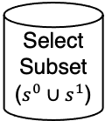
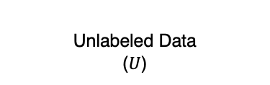
Practical Challenge #2: Big Data
Traditional Approach
Unlabeled Data ($U$)
Unlabeled Data ($U$)
Unlabeled Data ($U$)
…
Initial Subset ($s^{0}$)
Train
Model ($A_{0}^{}$)
Select Subset ($s^{0}∪s^{1}$)
Train
Model ($A_{1}^{}$)
Select Subset ($…∪s^{K}$)
Train
Model ($A_{K}^{}$)
Similarity search for Efficient Active Learning and Search (SEALS)
Unlabeled Data ($U$)
Unlabeled Data ($U$)
But instead of applying our selection strategy to all the unlabeled data, we use similarity search to find the closest examples and only consider them.
Initial Subset ($s^{0}$)
Train
Model ($A_{0}^{}$)
Select Subset ($s^{0}∪s^{1}$)
Coleman et al. “Similarity Search for Efficient Active Learning and Search of Rare Concepts.” 2022

Slide 37
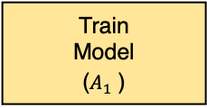
Practical Challenge #2: Big Data
Traditional Approach
Unlabeled Data ($U$)
Unlabeled Data ($U$)
Unlabeled Data ($U$)
…
Initial Subset ($s^{0}$)
Train
Model ($A_{0}^{}$)
Select Subset ($s^{0}∪s^{1}$)
Train
Model ($A_{1}^{}$)
Select Subset ($…∪s^{K}$)
Train
Model ($A_{K}^{}$)
Similarity search for Efficient Active Learning and Search (SEALS)
Unlabeled Data ($U$)
Unlabeled Data ($U$)
…
Take the newly labeled examples and find their neighbors. Then repeat
Initial Subset ($s^{0}$)
Train
Model ($A_{0}^{}$)
Select Subset ($s^{0}∪s^{1}$)
Train
Model ($A_{1}^{}$)
Coleman et al. “Similarity Search for Efficient Active Learning and Search of Rare Concepts.” 2022

Slide 38
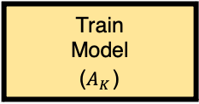
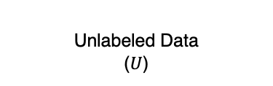
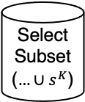
Practical Challenge #2: Big Data
Traditional Approach
Unlabeled Data ($U$)
Unlabeled Data ($U$)
Unlabeled Data ($U$)
…
Initial Subset ($s^{0}$)
Train
Model ($A_{0}^{}$)
Select Subset ($s^{0}∪s^{1}$)
Train
Model ($A_{1}^{}$)
Select Subset ($…∪s^{K}$)
Train
Model ($A_{K}^{}$)
Reach the same
accuracy
Similarity search for Efficient Active Learning and Search (SEALS)
Unlabeled Data ($U$)
Unlabeled Data ($U$)
Unlabeled Data ($U$)
…
Initial Subset ($s^{0}$)
Train
Model ($A_{0}^{}$)
Select Subset ($s^{0}∪s^{1}$)
Train
Model ($A_{1}^{}$)
Select Subset ($…∪s^{K}$)
Train
Model ($A_{K}^{}$)
Coleman et al. “Similarity Search for Efficient Active Learning and Search of Rare Concepts.” 2022

Slide 39
Active learning on ImageNet

Slide 40
Active learning on ImageNet

Slide 41
Active learning on ImageNet
SEALS is within 0.001 mAP while only considering < 10% of the unlabeled data.

Slide 42
Active learning on OpenImages (6.8M images)
SEALS is within 0.013 mAP while only considering < 1% of the unlabeled data.

Slide 43
Active learning on 10B images
SEALS is within 0.004 mAP while only considering < 0.1% of the unlabeled data.

Slide 44
Today’s Lecture
Why care about labels? Data-Centric vs Model-Centric AI (1/17)
Who labels and how? Dataset Creation and Curation (1/19)
What to label? Growing or Compressing Datasets (Today)
Active learning for growing datasets
Core-set selection for compressing datasets

Slide 45
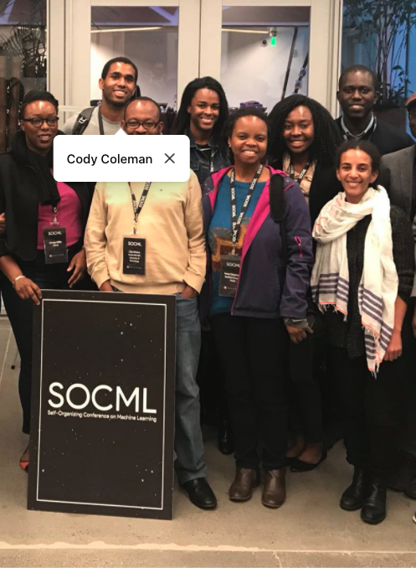
Large Labeled Datasets
Systematic feedback
Tagging friends in images
Flagging emails as spam
Rating items or movies
Self-supervision
Language modeling (e.g., BERT)
Computer vision (e.g., SimCLR)

Slide 46
What is core-set selection?
Active Learning
Unlabeled Data ($U$)
Unlabeled Data ($U$)
Unlabeled Data ($U$)
…
Initial Subset ($s^{0}$)
Train
Model ($A_{0}^{}$)
Select Subset ($s^{0}∪s^{1}$)
Train
Model ($A_{1}^{}$)
Select Subset ($…∪s^{K}$)
Train
Model ($A_{K}^{}$)
Core-set selection aims to select a small subset of data that accurately approximates the full dataset.

Slide 47
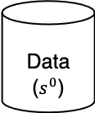
What is core-set selection?
Active Learning
Unlabeled Data ($U$)
Unlabeled Data ($U$)
Unlabeled Data ($U$)
…
Initial Subset ($s^{0}$)
Train
Model ($A_{0}^{}$)
Select Subset ($s^{0}∪s^{1}$)
Train
Model ($A_{1}^{}$)
Select Subset ($…∪s^{K}$)
Train
Model ($A_{K}^{}$)
Core-set Selection
Data ($s^{0}$)
Core-set selection aims to select a small subset of data that accurately approximates the full dataset.

Slide 48
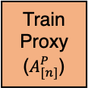
What is core-set selection?
Active Learning
Unlabeled Data ($U$)
Unlabeled Data ($U$)
Unlabeled Data ($U$)
…
Initial Subset ($s^{0}$)
Train
Model ($A_{0}^{}$)
Select Subset ($s^{0}∪s^{1}$)
Train
Model ($A_{1}^{}$)
Select Subset ($…∪s^{K}$)
Train
Model ($A_{K}^{}$)
Core-set Selection
Data ($s^{0}$)
Train
Proxy ($A_{[n]}^{P}$)
Core-set selection aims to select a small subset of data that accurately approximates the full dataset.

Slide 49
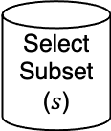
What is core-set selection?
Active Learning
Unlabeled Data ($U$)
Unlabeled Data ($U$)
Unlabeled Data ($U$)
…
Initial Subset ($s^{0}$)
Train
Model ($A_{0}^{}$)
Select Subset ($s^{0}∪s^{1}$)
Train
Model ($A_{1}^{}$)
Select Subset ($…∪s^{K}$)
Train
Model ($A_{K}^{}$)
Core-set Selection
Data ($s^{0}$)
Train
Proxy ($A_{[n]}^{P}$)
Select Subset ($s$)
Core-set selection aims to select a small subset of data that accurately approximates the full dataset.

Slide 50
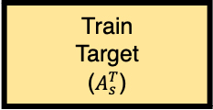
What is core-set selection?
Active Learning
Unlabeled Data ($U$)
Unlabeled Data ($U$)
Unlabeled Data ($U$)
…
Initial Subset ($s^{0}$)
Train
Model ($A_{0}^{}$)
Select Subset ($s^{0}∪s^{1}$)
Train
Model ($A_{1}^{}$)
Select Subset ($…∪s^{K}$)
Train
Model ($A_{K}^{}$)
Core-set Selection
Data ($s^{0}$)
Train
Proxy ($A_{[n]}^{P}$)
Select Subset ($s$)
Train
Target ($A_{s}^{T}$)
Core-set selection aims to select a small subset of data that accurately approximates the full dataset.

Slide 51
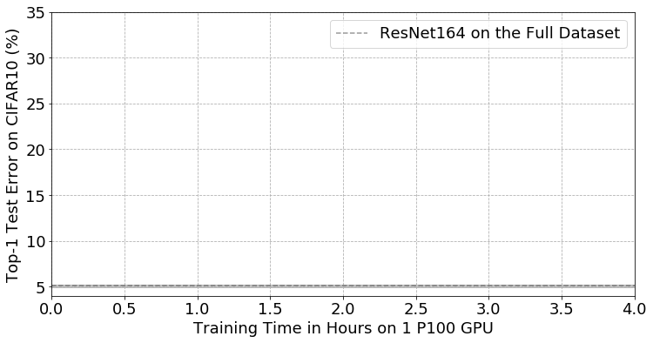
Coleman et al. “Selection via Proxy: Efficient Data Selection for Deep Learning.” 2020

Slide 52
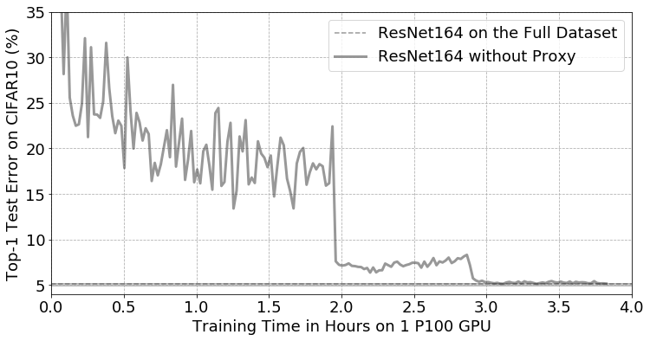
Training ResNet164 on CIFAR10 took 3 hours and 50 minutes using a P100 GPU.
Coleman et al. “Selection via Proxy: Efficient Data Selection for Deep Learning.” 2020

Slide 53
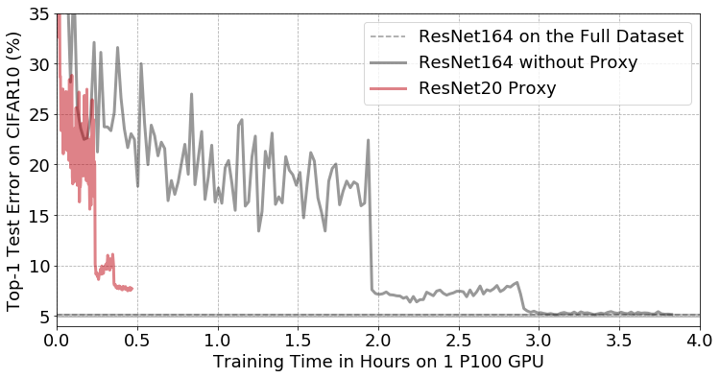
Training ResNet20 only takes 28 minutes and allows us to filter 50% of the data
Coleman et al. “Selection via Proxy: Efficient Data Selection for Deep Learning.” 2020

Slide 54
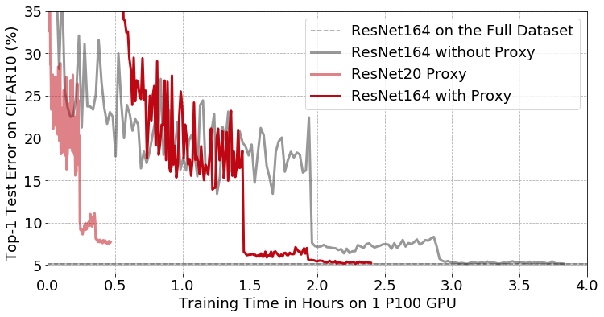
Training ResNet20 only takes 28 minutes and allows us to filter 50% of the data
without affecting the accuracy of ResNet164, leading to a 1.6x speed-up in time-to-accuracy
Coleman et al. “Selection via Proxy: Efficient Data Selection for Deep Learning.” 2020

Slide 55

This is only the tip of the Iceberg
What to label? Growing or Compressing Datasets
Active learning for growing datasets
Core-set selection for compressing datasets
Generative active learning…
Active search for drug discovery…
Hard example mining…
Curriculum learning...
And much more…

